Slide 1

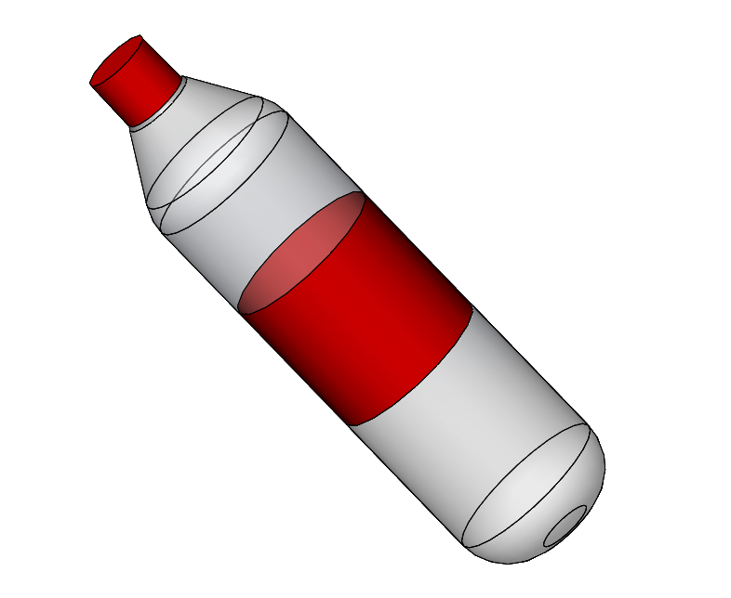
STI – robot competition
TEAM 3
Milestone number 2
Claudio Fritsche (GM)
Roman Oechslin (MT)
Héloïse Boross (MT)
20th March 2017

Slide 2
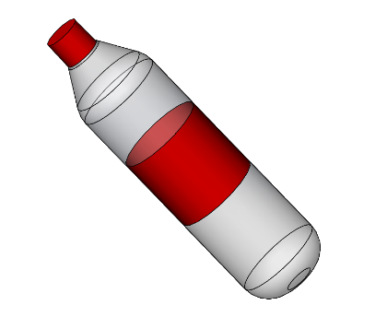
Functional Analysis
Mechanical Functions | Other Functions
Locomotion | Bottle Detection
Grabbing Mechanism | Obstacle Avoidance
Release Mechanism | Localisation and Navigation
Storage | Time Control
Energy Supply
2
Research Concept Implementation Risk management
Notes:
Claudio

Slide 3
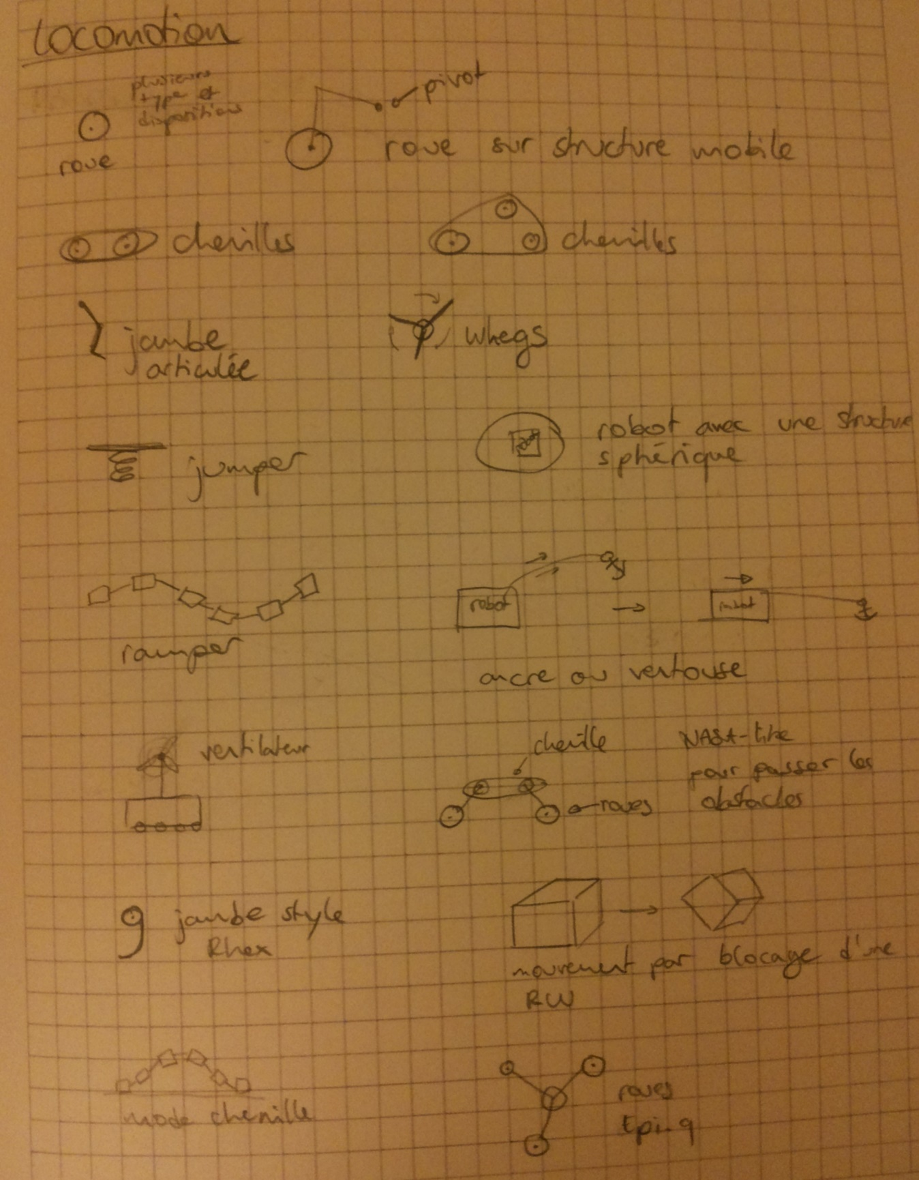
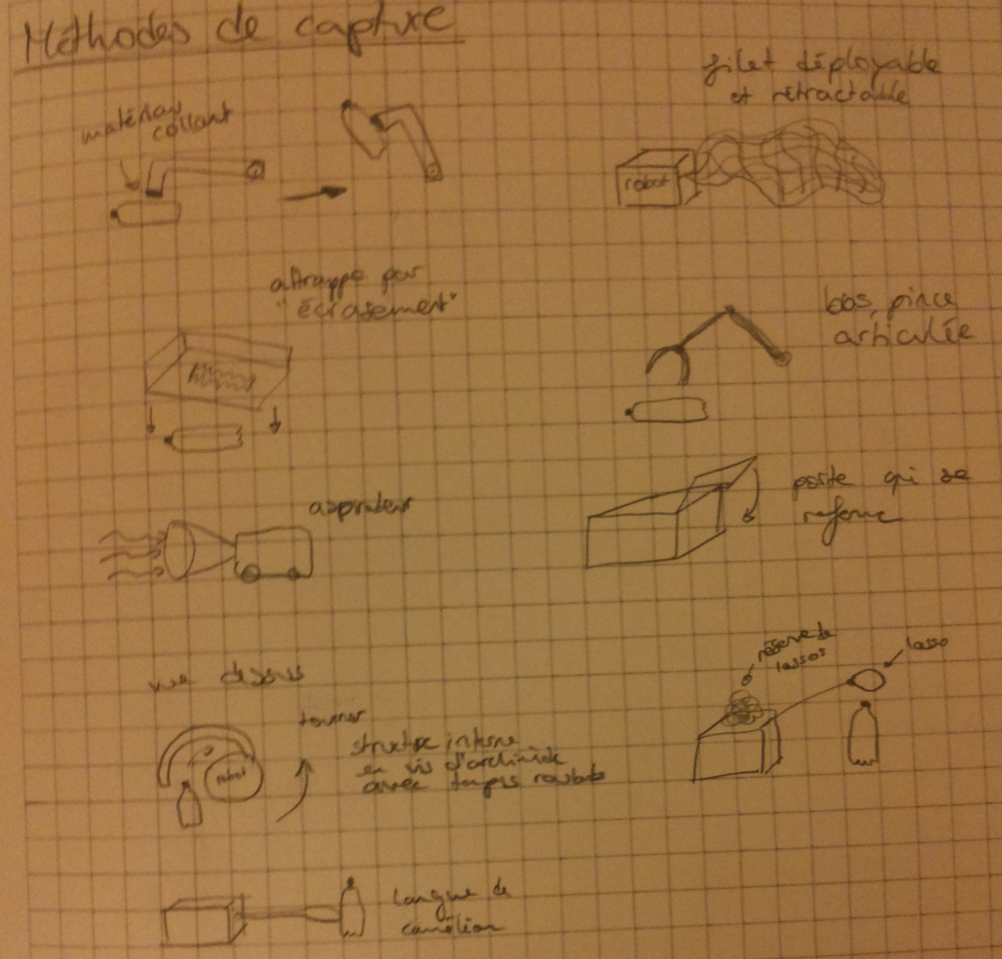
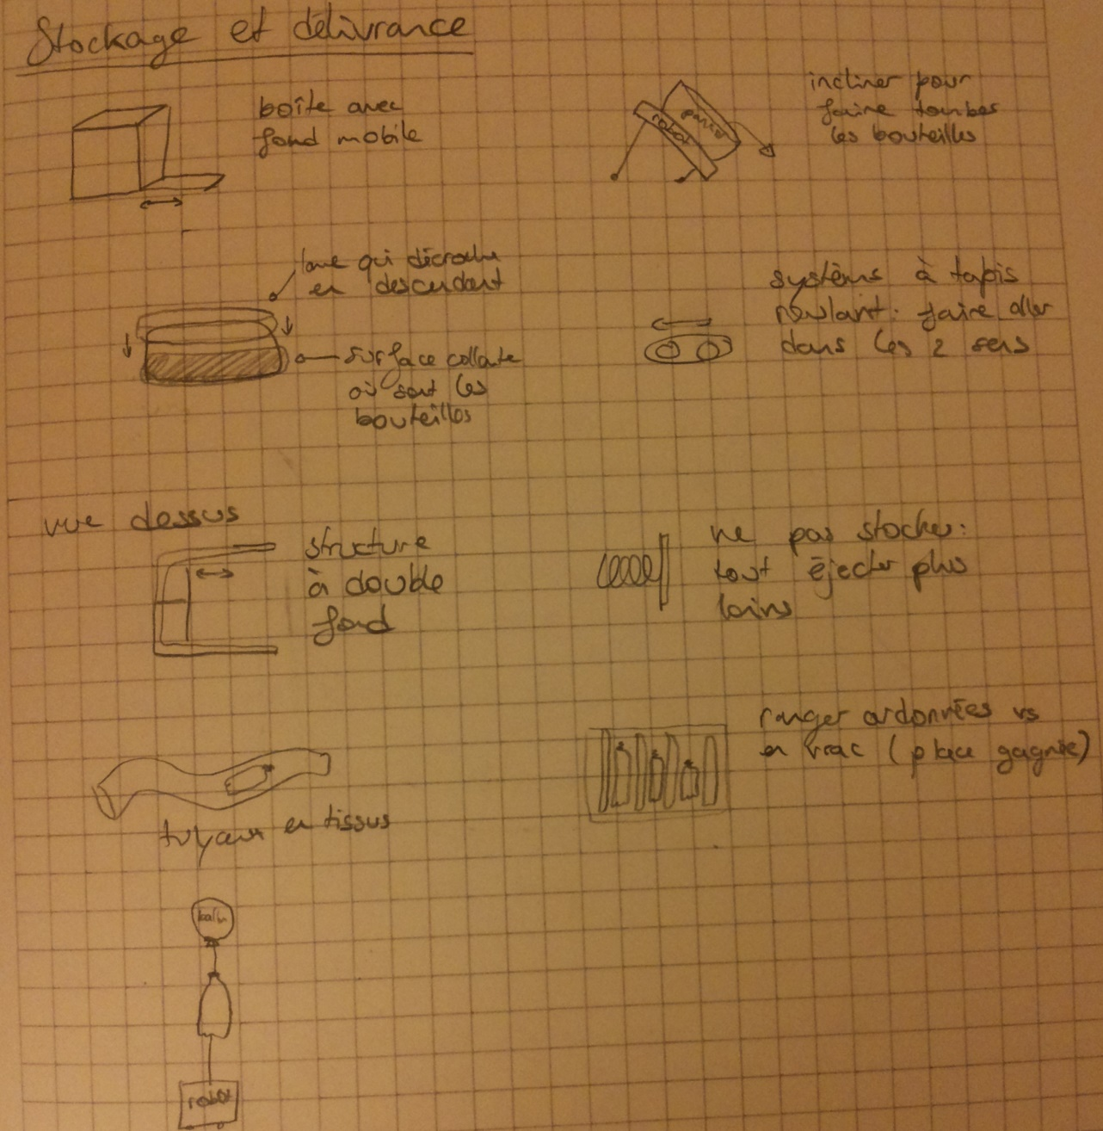
Brainstorming
3
Research Concept Implementation Risk management
Notes:
Héloïse

Slide 4
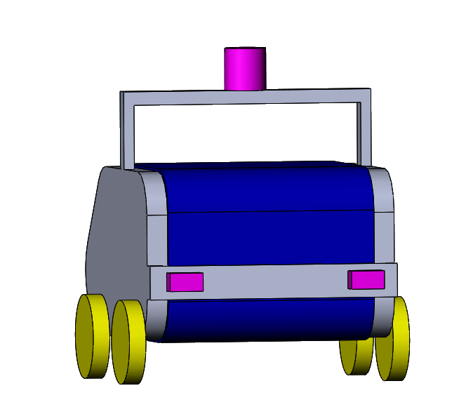
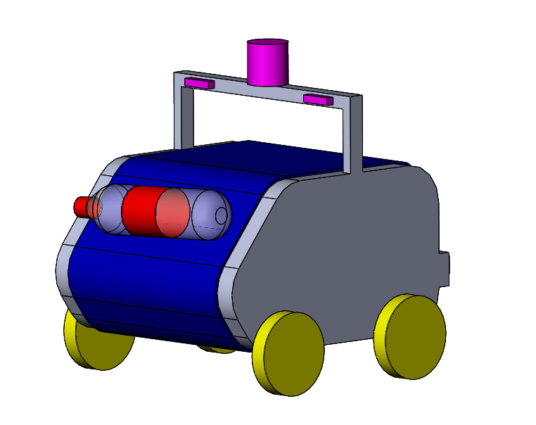
Robot Design
Grabbing mechanism: sticky conveyor belt
Navigation and obstacle detection sensors
Calibration sensors
Electronic and battery storage
Bottle releasing sensor
Locomotion system
Bottle releasing mechanism
4
Research Concept Implementation Risk management
Notes:
Héloïse
locomotion, grabbing, release —> good explanation
innovative

Slide 5
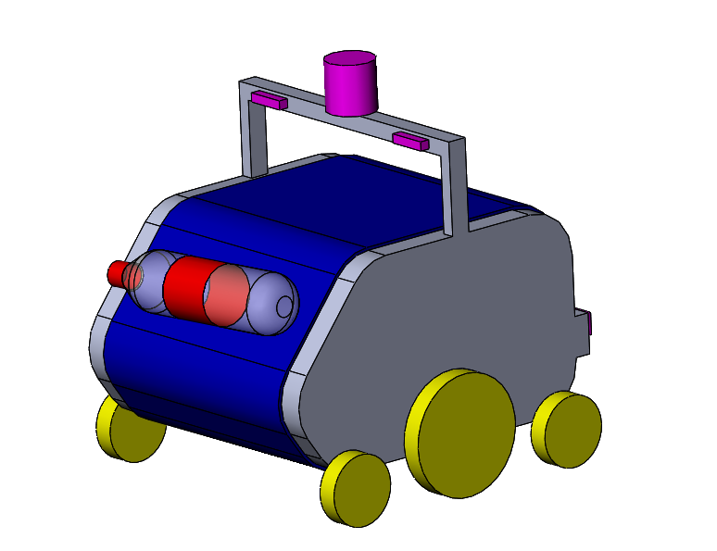
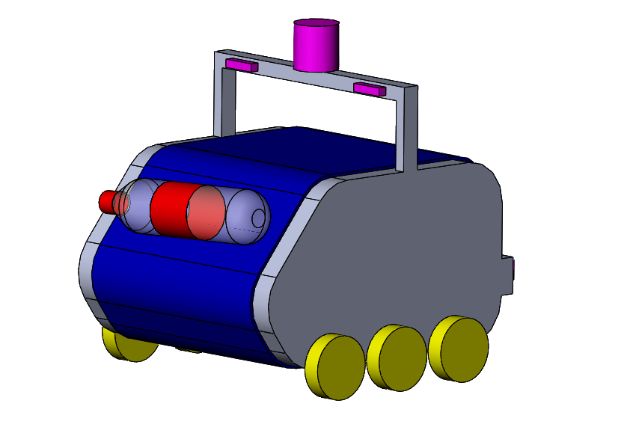
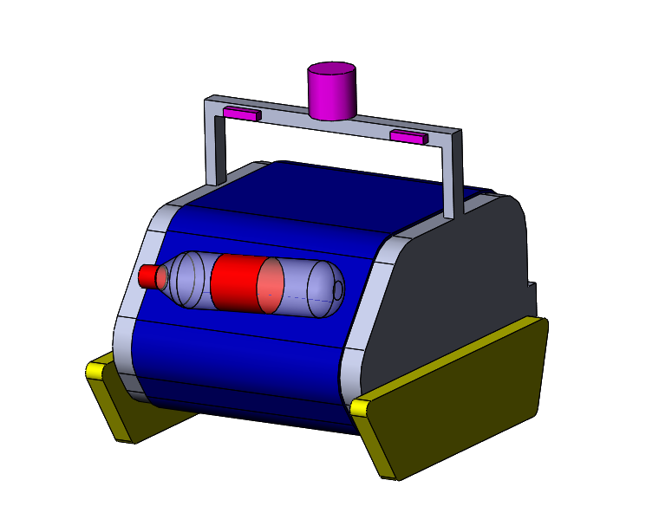
Robot Design
5
Research Concept Implementation Risk management
Notes:
Héloïse
locomotion, grabbing, release —> good explanation

Slide 6
Parts List
Function | Parts
Locomotion | Chassis | Motors (4x) | Controller (Arduino)
Grab and Release | Conveyor Belt | Sticky Surface | Motor
 | Barrier | Light Barrier Sensor | Encoder
Navigation | Encoders (2x) | Camera | Spherical Mirror
 | Bumpers (2x)
Bottle Detection | Camera | Raspberry Pi
Obstacle Avoidance | IR-Sensors
Energy Supply | Battery
6
Research Concept Implementation Risk management
Notes:
Claudio
Partslist:
Locomotion:
Chassis, Wheels (4x), Motors (4x), Controller (Arduino)
Grabbing + Release:
Conveyor Belt + Sticky surface, 1 Motor (+encoder?), Barrier, Light barrier sensor
Navigation:
encoders (2x or 4x?), camera, spherical mirror
Bottle detection:
Camera, Raspberry Pi with opencv and ROS
Obstacle avoidance:
IR-sensors,

Slide 7
Open CV
Why OpenCV?
It’s an open source computer vision library
Only one sensor (camera) for bottle detection in real time
What? | How? | To Do
Bottle Detection | Haar Cascade | Build Haar Classifier
Navigation | Triangulation with LED’s | Color detection, angle determination
Obstacle Avoidance | Haar Cascade | Build Haar Classifier
7
Research Concept Implementation Risk management
Notes:
Claudio

Slide 8
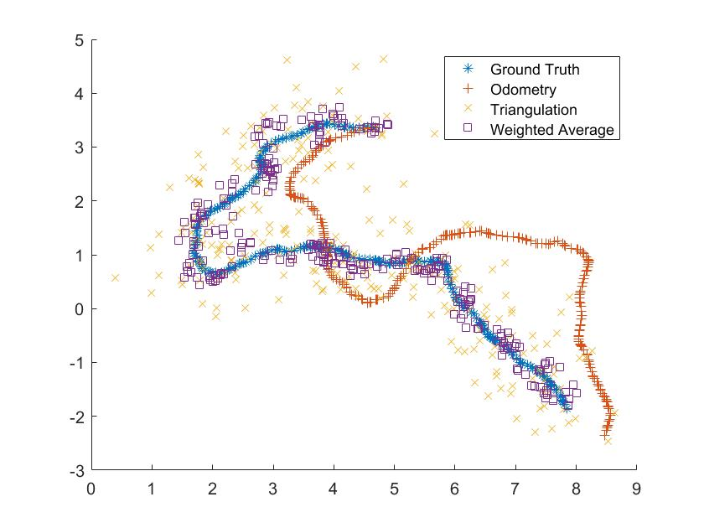
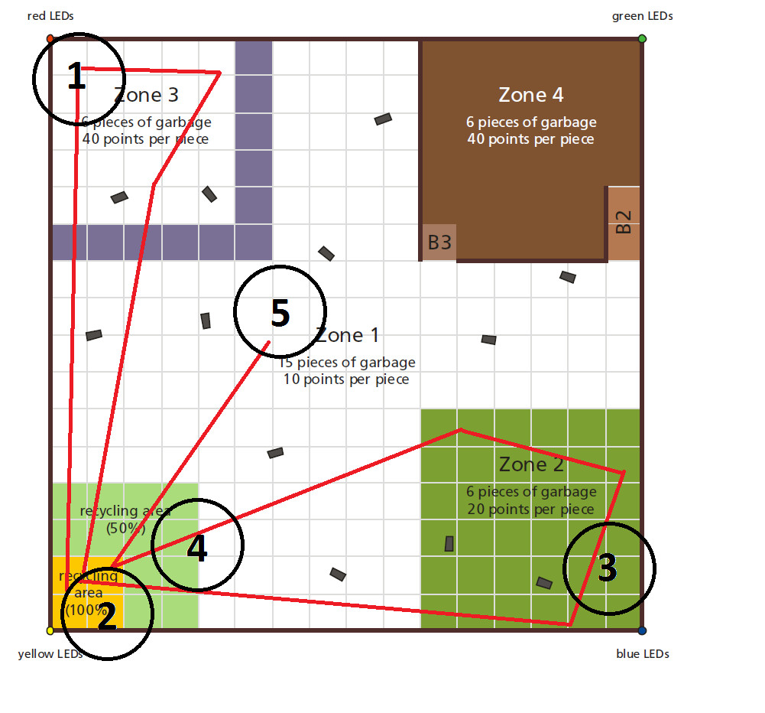
Navigation
SLAM / Kalman filter
Odometry (drift)
Triangulation (noisy)
Monocular vision
8
Research Concept Implementation Risk management
Notes:
Roman

Slide 9
Risk analysis
Probability | Problem | Solution
2 | Detection in OpenCV not reliable | Use backup sensors
2 | Navigation doesn’t work | Enough time for testing and improving, at least 2 methods
2 | Conveyor belt doesn’t rotate | Backup plan
3 | Sticky material is not available / damaged / dirty | Backup plan
3 | Malfunctioning of Sensors / Motors | Buy enough / Redundancy
4 | Get stuck on stones | Bigger wheels, tank treads
4 | No time for testing robot | Webots
5 | Don’t know orientation of bottles on conveyor belt | Light barrier
1: Low
5: High
9
Research Concept Implementation Risk management
Notes:
Roman

Slide 10
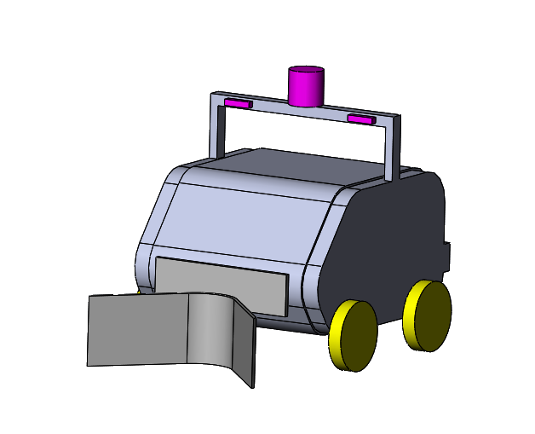
Back-up plan
10
Research Concept Implementation Risk management
Notes:
Roman

Slide 11
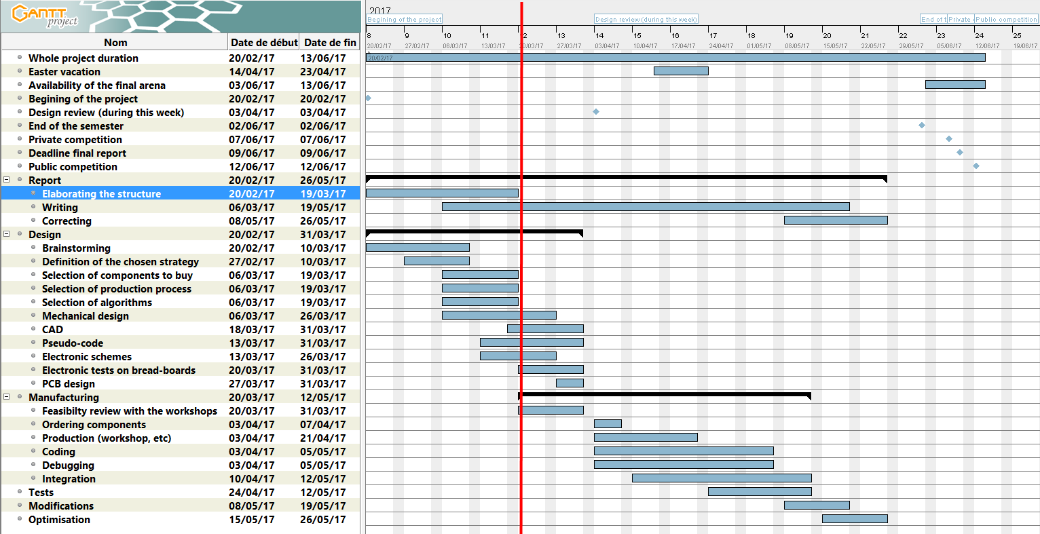
Time Management
11
Research Concept Implementation Risk management
Notes:
Roman

Slide 12
Thank you for your attention
Notes:
Questions?

